Slide 1

WELCOME TO PYTHON

Slide 2
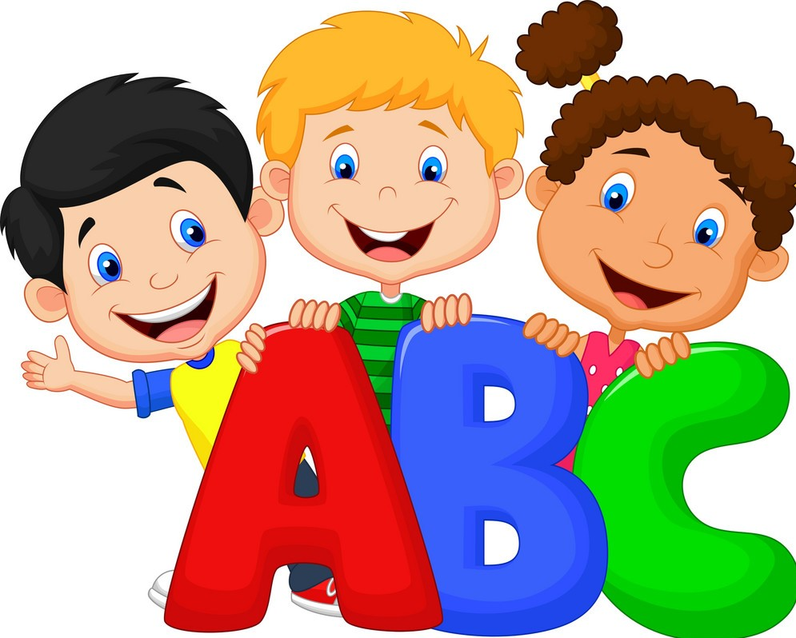
Kids learning game
INTORDUCTION

Slide 3
Graphical User interface
User Friendly Window and user interactive interface
Starting and Front Interface with Images
Set window size by Geometry
Button, Frame, Entry and Images

Slide 4








GUI

Slide 5
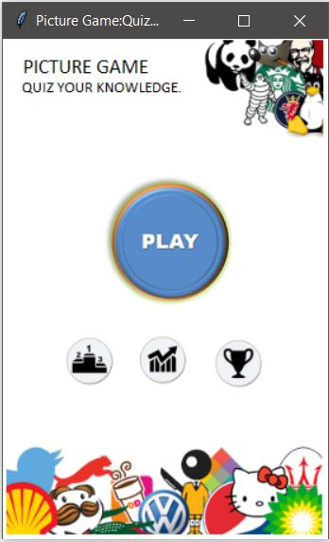

Slide 6
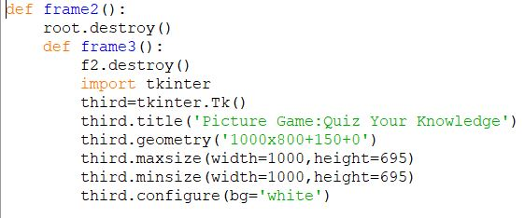
Python programming

Slide 7
Display
Process
Function_1
Function_3
Function_2
Sub Function
Sub Function

Slide 8
Thank you

